Slide 1




2023 International Workshop on Microfluidic Chemical Plant
International University-Industry Collaboration for Innovation
13-14 March, Hsinchu, Taiwan
Monday 13 March
9:00-16:00 | Registration Open | Lobby
9:45-10:15 | Opening Ceremony (Chair: Prof. Chihchen Chen, NTHU)
Greetings 9:45-10:10 | W. John Kao (President, NTHU), Yoshimi Ogawa (CEO, Daicel), Yu-Han Tsou (Senior Advisor, STD-JP), Chih-Peng Li (Director General, NSTC), Fan-Gang Tseng (Distinguished Prof., NTHU), Takehiko Kitamori (Yushan Honorary Chair Prof., NTHU) | Sun Yun-Suan Lecture Hall
10:10-10:15 | Group Photo
Opening Speech 10:15-11:15 | Introduction of the Daicel Project Yoshimi Ogawa (CEO, Daicel) and Takehiko Kitamori (Yushan Honorary Chair Prof., NTHU)
Plenary Lecture 11:15-12:00 | Accelerating Chemical Discovery and Development with Microfluidics, Automation, and AI Klavs F. Jensen (Prof., MIT)
12:00-12:15 | Group Photo | TSMC Build.
12:15-13:15 | IMT Lunch | Room 104
13:15-14:20 | Lab tour (1st DTP) | Chem. Lab
14:20-17:00 | Taiwan-Japan International Exchange and UIC (moderator: Prof. Chihchen Chen, NTHU)
14:20-14:25 | Takashi Hattori (Deputy Representative, Japan-Taiwan Exchange Association) | Sun Yun-Suan Lecture Hall
14:25-14:45 | Yu-Han Tsou (Senior Advisor, STD-JP)
14:45-15:05 | Shinobu Yoshimura (ED/VP, UTokyo)
15:05-15:15 | Fan-Gang Tseng (Distinguished Prof., NTHU)
15:15-15:25 | Cheng-Yao Lo (Director, DGM, NTHU)
15:25-16:00 | Coffee Break | Lobby
Panel Discussion 16:00-17:00 | Panelists: Yu-Han Tsou, Shinobu Yoshimura, Fan-Gang Tseng, Cheng-Yao Lo, Yoshimi Ogawa, and Takehiko Kitamori | Sun Yun-Suan Lecture Hall
18:00-21:00 | IMTT Banquet
18:00-18:15 | Welcoming, Mitsuhiro Kurihara (CEO, IMTT) | 2F, HO Hotel
 | Remarks: Po-Wen Chiu (Vice President, NTHU), Hung-Yin Tsai (Dean, CoE, NTHU), Chih-Yung Huang (Chairman, PME, NTHU), Sheng-Shian Li (Director, iNEMS, NTHU)
Workshop Language: English website: https://ocic.iih.nthu.edu.tw/news_detail.php?news_rkey=AYAPWLSV93
Contact: chihchen@mx.nthu.edu.tw
Sponsors:
Organizer: Daicel-NTHU Research Center
Co-organizers:
NTHU Operations Center for Industry Collaboration
Society of Power Mechanical Engineering, Hsinchu

Slide 2
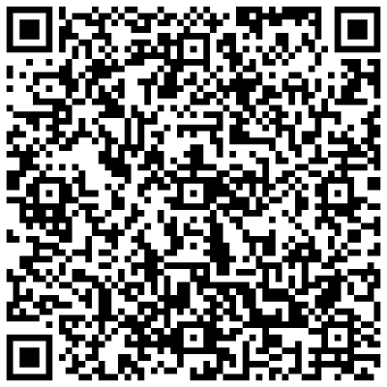
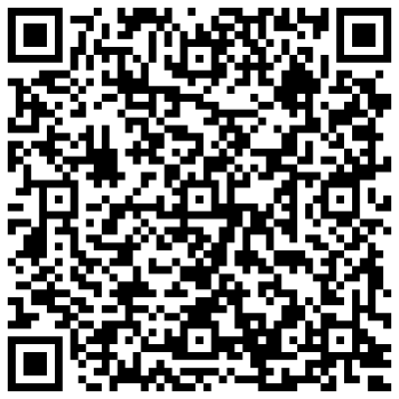
2023 International Workshop on Microfluidic Chemical Plant
International University-Industry Collaboration for Innovation
13-14 March, Hsinchu, Taiwan
Tuesday 14 March
8:00-16:00 | Registration Open | Lobby
8:30-10:00 | Microfluidics (I) (Chair: Assist. Prof. Kyojiro Morikawa, NTHU)
Keynote 8:30-9:00 | Development of Desktop Chemical Plant by Numbering Up Microfluidic Reactors, Katsunori Konishi (IMTT) | Sun Yun-Suan Lecture Hall
9:00-9:20 | Flow Control System for Multiple Microfluidic Devices with Manifold in DTP System, Hiroki Sano (IMTT)
9:20-9:40 | Temperature Control System for Individual Microfluidic Devices in DTP System, Yen Lin (IMTT)
9:40-10:00 | Pressure-driven Flow Control System with Numbering-up Structure for Multistep Continuous Flow Processes, Kao-Mai Shen (NTHU)
10:00-10:30 | Poster session/Coffee Break | Lobby
10:30-12:00 | Chemical Reaction & Processing (I) (Chair: Assist. Prof. Hisashi Shimizu, UTokyo)
Keynote 10:30-11:00 | Methods of Incorporating Catalysts into Microchannels Based on Structure and Function and Their Application to Organic Synthesis, Ueno Masaharu (Tokushima University) | Sun Yun-Suan Lecture Hall
11:00-11:20 | High Temperature Chemical Synthesis on a Microfluidic Chip, Adelina Smirnova (UTokyo)
Keynote 11:20-11:50 | Development of Microfluidic Immunoassay Devices for Predicting Prognosis of Brain Tumor Patients, Toshihiro Kasama (UTokyo)
11:50-13:00 | IMT Lunch / Lab tour (1st DTP) | Room 104
13:00-14:30 | Chemical Reaction & Processing (II) (Chair: Assist. Prof. Toshihiro Kasama, UTokyo )
Keynote 13:00-13:30 | Nanofluidic Enzyme Reactor Utilizing Reaction at Solid/Liquid Interface on Nanochannels, Kyojiro Morikawa (NTHU) | Sun Yun-Suan Lecture Hall
Keynote 14:00-14:30 | Femtoliter Solvent Etraction by Parallel Two-Phase Flows in Nanofluidic Channels, Yutaka Kazoe (Keio University)
Keynote 14:30-15:00 | Microfluidic Lipid Membrane Platforms for Separating Cell Membrane Proteins, Ling Chao (NTU)
14:30-15:00 | Poster session/Coffee Break | Lobby
15:00-16:30 | Microfluidics (II) (Chair: Prof. Chihchen Chen, NTHU)
Keynote 15:00-15:30 | Chemical Sensing in Micro/Nanochannels by Photothermal Spectroscopy, Hisashi Shimizu (UTokyo) | Sun Yun-Suan Lecture Hall
15:30-15:50 | High Density Slurry Handling in Microchannels, Ryoichi Ohta (UTokyo)
Plenary 15:50-16:30 | Large-scale Serial-Parallel Microfluidic Device System for Desktop Chemical Plant Takehiko Kitamori (Yushan Honorary Chair Prof., NTHU)
16:30-17:00 | Poster Awards and Closing Remarks
Lecturers
Plenary
Klavs F. Jensen (MIT)
Takehiko Kitamori (NTHU)
Keynote
Katsunori Konishi (IMT Taiwan) Masaharu Ueno (Tokushima U)
Hisashi Shimizu (U Tokyo) Kyojiro Morikawa (NTHU)
Event Registration
Abstract Submission
Workshop Language: English Contact: chihchen@mx.nthu.edu.tw
Sponsors:
Organizer: Daicel-NTHU Research Center
Co-organizes:
NTHU Operations Center for Industry Collaboration
Society of Power Mechanical Engineering, Hsinchu

